Slide 1

Daily Work Tracker
Proposal

Slide 2
Introduction
A Daily Work Tracker is a valuable tool for individuals and teams in our fast-paced world. It helps users manage their daily tasks, time, and goals effectively, providing a structured framework for planning, execution, and monitoring.
This tool converts disorganized to-do lists into structured plans, promoting increased productivity and a sense of command. It goes beyond being a mere planner; it serves as a partner for personal development, providing valuable insights into work routines and improving teamwork.
In summary, a Daily Work Tracker empowers users to make the most of their time, align with objectives, and achieve a more organized work, productive and help organization grow.

Slide 3
Objectives
To assess the impact of using a Daily Work Tracker on individual and team productivity in a fast-paced work environment.
To explore how a Daily Work Tracker helps individuals and teams effectively manage their daily tasks, time, and goals.
To investigate the ways in which a Daily Work Tracker contributes to converting disorganized to-do lists into structured plans and its influence on productivity and a sense of control.
To examine the additional benefits of a Daily Work Tracker in terms of personal development, insights into work routines, and improvements in teamwork.
To analyze how a Daily Work Tracker empowers users to optimize their time, align with objectives, and achieve a more organized, productive.

Slide 4
Scope
Limitations
1
Task Management
Limited Automation
1
2
Time Tracking
2
Complex Goal Setting
3
Priority Setting
Advanced Platform Support
3
4
Goal Setting
Privacy Concerns
4
5
Progress Tracking
Resistance from Employees
5
6
Accessibility
7
Cross-Platform Compatibility
Admin Access
6
Notes:
Task Management: to create, edit, and manage tasks or to-do items efficiently.
Time Tracking: to record the time spent on tasks for time management and productivity analysis.
Priority Setting: prioritizing tasks based on importance and urgency.
Goal Setting: capability to set and track daily, weekly, or long-term goals.
Progress Tracking: tools for monitoring the progress of tasks and goal achievement.
Accessibility: availability on various platforms (desktop) to ensure accessibility from different devices.
Cross-Platform Compatibility: compatibility with different operating systems and devices for wider usability.
-----------------------------------------------------------------------------------------------------------
Limited Automation: The scope does not explicitly mention automation features
Complex Goal Setting: While it covers basic goal setting, more advanced features like goal dependencies, milestone tracking may not include.
Advanced Platform Support: The user can access the Application System using Desktop Computer
Privacy Concerns: many time tracking programs demand access to sensitive information
Resistance from Employees: Employees may feel that is invasion of their privacy.
Admin Access: Administrative cannot use the camera of the user’s laptop if it’s using the computer.

Slide 5
Cost and Benefits Analysis
Requirements |  |  |  | Cost
Development Computer/Laptop | 5th Generation Intel Core i3 Processors (Higher 5th Gen) | 4gb RAM | Windows 10 or Later | 30,989.99
Requirements |  | Speed | Limit | Cost
Operational Internet Connection | PLDT Fibr Plan 1699 | 100Mbps | Unlimited | 1, 699

Slide 6














Use Case Diagram

Slide 7
First Level DFD
Main Entities and Output
Username
Generate User’s Report
Password
Daily Work Tracker
Generate Daily Report
Login
Generate Weekly Report
Register
Generate Yearly Report
Change Password
Generate all records
Notes:
-Username records and generate report of all Username
-Password records nd generate report of all Password
-Register records and generate report of all Register
-Change Password records and generate report of all Change Password
-Authentiaction records and generate report of all Authentication
-Login records and generate report of all Login

Slide 8

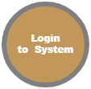



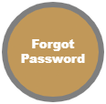


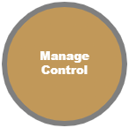







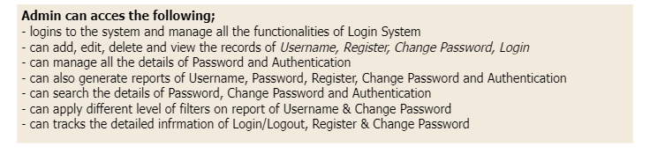
Second Level DFD
Notes:
Admin can acces the following;
- logins to the system and manage all the functionalities of Login System
- can add, edit, delete and view the records of Username, Register, Change Password, Login
- can manage all the details of Password and Authentication
- can also generate reports of Username, Password, Register, Change Password and Authentication
- can search the details of Password, Change Password and Authentication
- can apply different level of filters on report of Username & Change Password
- can tracks the detailed infrmation of Login/Logout, Register & Change Password

Slide 9
Users Flow in Office Base
Daily Tracker
Click Time-in
Fingerprint Biometric
Update to Database, where user is already time in
User Log-in to the tracking system –to check if it’s already time-in
End

